Slide 1

Addressing Modes
The addressing mode specifies a rule for interpreting or modifying the address field of the instruction before the operand is actually referenced.
Computers use addressing mode techniques for the purpose of accommodating one or both of the following provisions:
To give programming versatility to the user by providing such facilities as pointers to memory, counters for loop control, indexing of data, and program relocation.
2. To reduce the number of bits in the addressing field of the instruction.
Instruction Format
The operation code specifies the operation to be performed.
The mode field is used to locate the operands needed for the operation.
There may or may not be an address field in the instruction. If there is an address field, it may designate a memory address or a processor register.

Slide 2
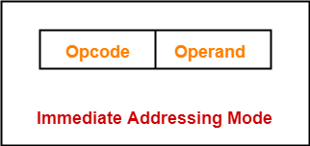
Although most addressing modes modify the address field of the instruction, there are two modes that need no address field at all. These are the implied and immediate modes.
Implied Mode: In this mode the operands are specified implicitly in the definition of the instruction. For example, the instruction "complement accumulator“ is an implied-mode instruction because the operand in the accumulator register is implied in the definition of the instruction.
Immediate Mode − In this mode, the operand is specified in the instruction itself.
In other words, an immediate-mode instruction has an operand field instead of an address field.
The operand field includes the actual operand to be used in conjunction with the operation determined in the instruction.

Slide 3
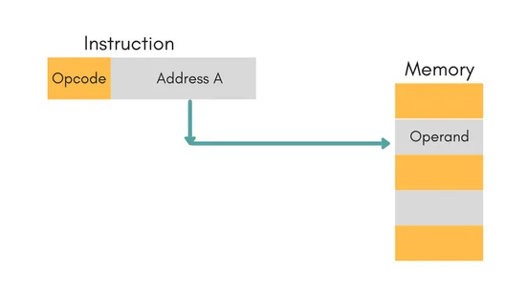
3. Direct Address Mode − In this mode, the effective address is equal to the address part of the instruction. The operand resides in memory and its address is given directly by the address field of the instruction.
Ex. ADD X will increment the value stored in the accumulator by the value stored at memory location X. AC ← AC + M[X]

Slide 4
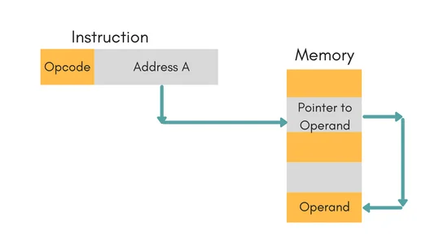
4. Indirect Address Mode − In this mode, the address field of the instruction gives the address where the effective address is stored in memory. Control fetches the instruction from memory and uses its address part to access memory again to read the effective address.
Ex. ADD X will increment the value stored in the accumulator by the value stored at memory location specified by X.
AC ← AC + M[[X]]

Slide 5
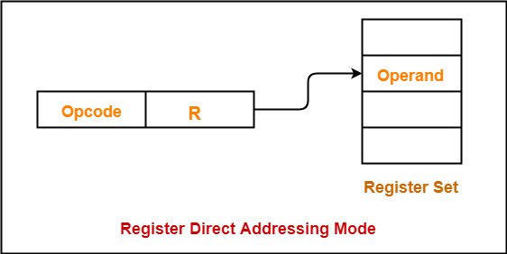
5. Register Mode/ Register Direct Addressing Mode − In this mode, the operands are in registers that reside within the CPU. The specific register is selected from a register field in the instruction. A k-bit field can determine any one of the 2^{k} registers.
Ex. ADD R will increment the value stored in the accumulator by the content of register R.
AC ← AC + [R]

Slide 6
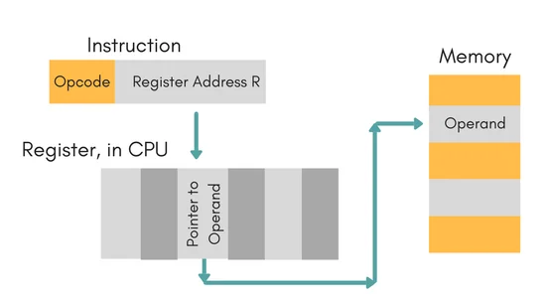
6. Register Indirect Mode − In this mode, the instruction defines a register in the CPU whose contents provide the address of the operand in memory. In other words, the selected register includes the address of the operand rather than the operand itself.
Ex. ADD R will increment the value stored in the accumulator by the content of memory location specified in register R.
AC ← AC + [[R]]

Slide 7
7. Auto increment or Auto decrement Mode: This is similar to the register indirect mode except that the register is incremented or decremented after (or before) its value is used to access memory.
Displacement Addressing Mode: A very powerful mode of addressing combines the capabilities of direct addressing and register indirect addressing, which is broadly categorized as displacement addressing:
EA = A + (R)
Displacement addressing requires that the instruction have two address fields, at least one of which is explicit. The value contained in one address field (value = A) is used directly.
The other address field, or an implicit reference based on opcode, refers to a register whose contents are added to A to produce the effective address.

Slide 8
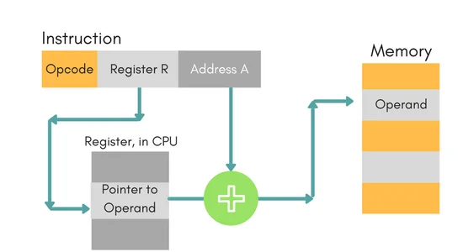

Slide 9
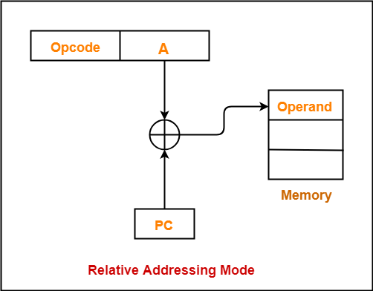
Three of the most common use of displacement addressing are:
1. Relative Addressing Mode: In this mode the contents of PC (Program Counter) is added to address part of instruction to obtain the effective address.
EA = A + (PC), where EA is effective address and PC is program counter.

Slide 10
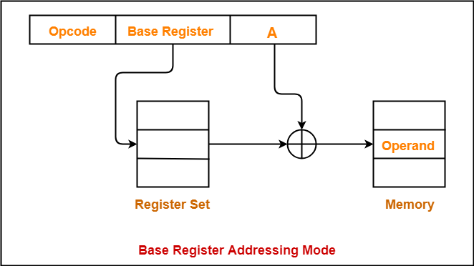
2. Base-Register Addressing: In this mode the contents of Base Register is added to address part of instruction to obtain the effective address
EA= A + Base Register

Slide 11
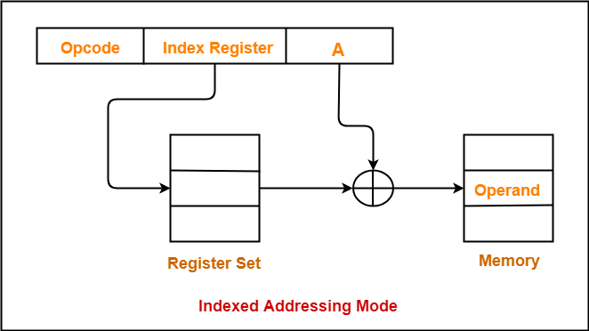
3. Indexed Addressing Mode: In this mode the contents of Index Register is added to address part of instruction to obtain the effective address
EA= A + Index Register

Slide 12
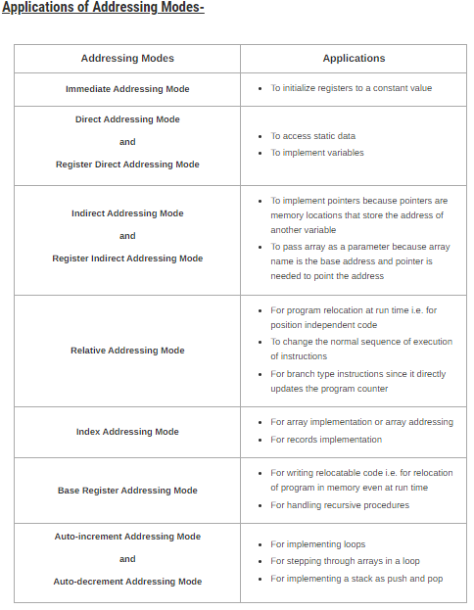

Slide 13
